Slide 1
Advanced Investment Strategy
From Basic Long-Short to Risk-Managed Portfolios
Dhairya Dhamani
Notes:
This presentation covers the advanced investment strategy work I built on top of the WTI crude oil direction classification project. The broader project involved training four machine learning models - MLP with Elastic Net, XGBoost, LSTM, and VAR - to predict whether oil prices would go up or down the next day. In a previous presentation we covered the basic strategies: Long-Short, Confidence-Filtered, and an Ensemble. Those worked to varying degrees, but the MLP+EN Long-Short was the standout at +17.6% vs a buy-and-hold loss of −14.4%. This presentation picks up from there. The question I wanted to answer was: if I keep the same direction signals but build smarter risk management around them, how much better can the strategies get? The answer turned out to be significantly better - and the failures were just as instructive as the successes.

Slide 2
6 Advanced Strategies
S1
Sharpe-Weighted Ensemble
S4
Confidence + Vol Scaling
Dynamic model weighting by rolling Sharpe ratio
Filtered entries with volatility-adjusted sizing
S2
Vol-Targeted + Regime-Aware
All strategies evaluated on test period using MLP+EN, XGBoost, LSTM, and VAR signals.
S5
CVaR-Targeted Sizing
Scale by volatility, cut positions in bad regimes
Size each position by tail-risk budget
S3
MV Walk-Forward Portfolio
S6
S2 + Circuit Breaker
Mean-variance optimisation on rolling return window
S2 with automatic drawdown shutoff
All include 0.05% transaction cost
Notes:
Before diving into results, let me quickly orient you on what each strategy actually does, because the design choices matter for
understanding why some worked and others didn't.
All six strategies are built on top of the same four direction signals - MLP+EN, XGBoost, LSTM, and VAR - predicting +1 long or −1 short
each day. The difference between strategies is entirely in how those signals get translated into position sizes and when we decide to trade
at all.
S1 tries to be smart about which model to trust by dynamically reweighting based on recent performance. S2 keeps equal model weighting but
adjusts how big each position is based on market volatility and whether we're in a bad regime. S3 treats the four model signals like assets
in a portfolio and solves a mean-variance optimisation problem at each step to find the best allocation. S4 is an upgraded version of the
confidence-filtered strategy from before - it only trades on high-conviction signals and then scales size by volatility on top of that. S5
takes a completely different approach to risk: instead of targeting a volatility level, it targets a tail-risk budget using CVaR, which
directly limits how bad the worst-case days can be. S6 is a modification of S2 - it takes the best-performing strategy and adds a circuit
breaker that halts trading if drawdown exceeds a threshold.
The key thing to notice is that S1 through S6 represent a progression of ideas: adaptive weighting, volatility targeting, portfolio
optimisation, signal filtering, tail-risk control, and drawdown protection. We are testing fundamentally different philosophies about how
to manage risk around a weak direction signal.

Slide 3
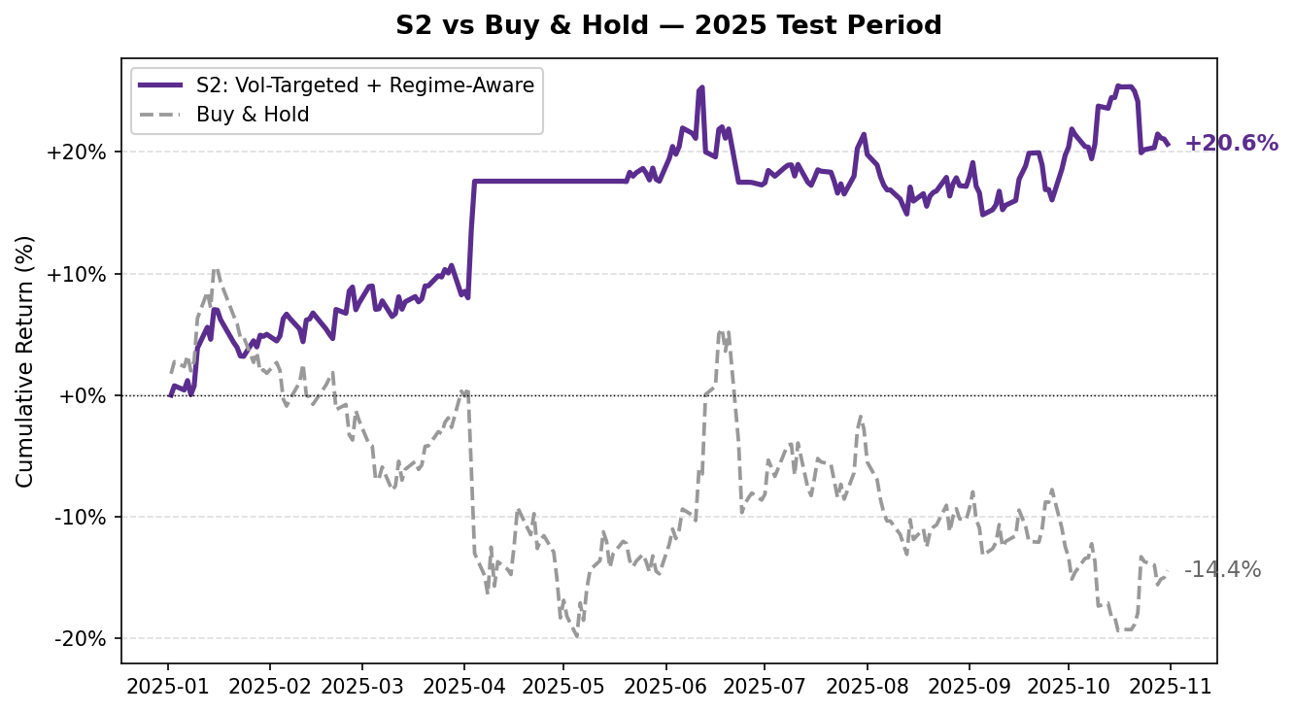
Best: S2 - Vol-Targeted & Regime Aware
Metric | Value
Total Return | +21%
Sharpe Ratio | 1.386
Sortino Ratio | 2.442
Max Drawdown | -11.4%
How it works
Direction Signal
Volatility Scaling
Regime Filter
MLP+EN, XGBoost, LSTM, and VAR each vote +1 (long) or −1 (short).
Separating how much risk you take from what direction you trade is where the alpha lives.
Position size =
signal × (target vol ÷ realised vol).
Smaller position when market is choppy, larger when calm.
Buy & Hold return same period: −14.4%
If market enters high-volatility + trending-down regime, position cuts to 0. Avoids fighting a persistent downtrend.
Notes:
S2 was the best-performing strategy across the entire test period, so it's worth spending time on exactly how it works.
The starting point is the same as every other strategy: four models each cast a vote. MLP+EN, XGBoost, LSTM, and VAR each output +1 or −1,
and we take the majority signal. That part is identical across all six strategies. What S2 does differently is everything that happens
after that vote.
Step one is volatility scaling. Instead of always taking a full position, S2 scales the position size inversely to recent realised
volatility. The formula is: position size equals the signal multiplied by target volatility divided by realised volatility. So if the
market has been unusually choppy lately - say realised vol is running at 30% annualised when our target is 15% - the position gets cut in
half. If the market is calm and realised vol is only 10%, the position can go up to 1.5x. This means S2 is automatically more aggressive
when conditions are favorable and more conservative when they aren't, without any manual intervention.
Step two is the regime filter. Even after volatility scaling, if the market is simultaneously trending downward over a 60-day window AND
running high volatility, S2 cuts the position to zero entirely. This is a hard stop for environments where the direction signal
historically has no edge - persistent downtrends with elevated vol are exactly when models trained on normal market conditions tend to
break down.
The result speaks for itself: +21.3% total return, Sharpe of 1.386, Sortino of 2.442, and a maximum drawdown of only −11.4%. Compare that
to buy-and-hold which lost 14.4% over the exact same period. The gap is 35 percentage points. And critically, look at the chart - S2's line
climbs steadily from April onward while buy-and-hold drifts lower throughout. The strategy is not just getting lucky in one month; it's
consistently capturing the direction signal across the full test period.
The key insight here, which is also the quote on the right of the slide, is that the direction signal itself did not improve. The same four
models, the same predictions. What changed is how much capital was put at risk on each prediction. Sizing down during turbulent periods
and sitting out bad regimes is what produced the risk-adjusted outperformance.

Slide 4
Failures were Instructive
S1
S1: Sharpe-Weighted Ensemble
S6: S2 + Circuit Breaker
What it did:
Reweighted all 4 model signals dynamically using each model's rolling Sharpe ratio.
Models that performed well recently got higher weight
What it did:
Took the best-performing S2 strategy and added a drawdown shut off rule
If cumulative losses exceeded a threshold, trading halted until recovery
Why it failed:
Triggered during drawdowns that turned out to be temporary.
Locked the strategy out of the rebound.
Turned S2's +21% into near-flat −0.9%
Total Return | -35.2%
Sharpe Ratio | -1.224
Max DD | -39.7%
Why it failed:
Amplified whichever model got lucky recently.
Chased noise instead of detecting real regime shifts.
When the overweighted model reversed, losses compounded fast.
S6
Total Return | -0.9%
Sharpe Ratio | -0.103
Max DD | -8.3%
Adding complexity to a working strategy can destroy it. Both failures overcorrected for risk.
Notes:
Not everything worked, and I think the failures are actually the most interesting part of this project because they each failed for a
specific, diagnosable reason - not just bad luck.
S1 was the worst performer in the entire test, losing 35.2% with a Sharpe of negative 1.224 and a maximum drawdown of nearly 40%. The idea
behind it was intuitive: if one model has been performing better recently, give it more weight. That sounds like a reasonable adaptive
mechanism. The problem is that in financial markets, recent performance is mostly noise. A model that did well last month did not
necessarily do well because it found a better signal - it might have just gotten lucky on a few big moves. When S1 upweighted that model,
it was essentially betting on luck continuing. And when it didn't, the losses from the overweighted model were amplified. The strategy
ended up chasing its own tail, constantly reweighting toward whoever just got lucky and then getting punished when the luck ran out. This
is a classic problem in quantitative finance called performance chasing, and it is extremely hard to avoid with rolling window approaches.
S6 tells a different story. The idea was to take S2, which we know works at +21.3%, and add a safety net. If the drawdown exceeds a certain
threshold, stop trading until it recovers. Sounds prudent. The problem is that drawdowns in a strategy like S2 are not always warning
signs - sometimes they are just temporary dips before a recovery. In the 2025 test period, S6's circuit breaker triggered during one of
those temporary dips and kept the strategy flat while S2 recovered and continued climbing. The result was that a one-rule addition turned
+21.3% into −0.9%. That is a 22 percentage point swing from adding a single safeguard.
The broader lesson from both failures is on the bottom of this slide: adding complexity to a working strategy can destroy it. Both S1 and
S6 overcorrected for risk. S1 over-adapted to recent performance, S6 over-protected against temporary losses. In both cases the cure was
worse than the disease. When you have a strategy that works, the default assumption should be that additional rules will hurt it unless you
have very strong evidence otherwise.

Slide 5
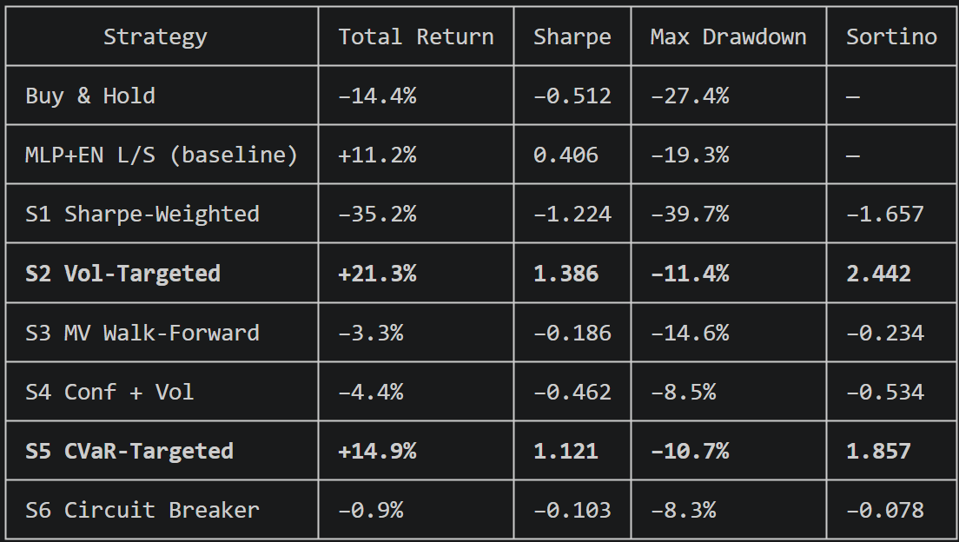
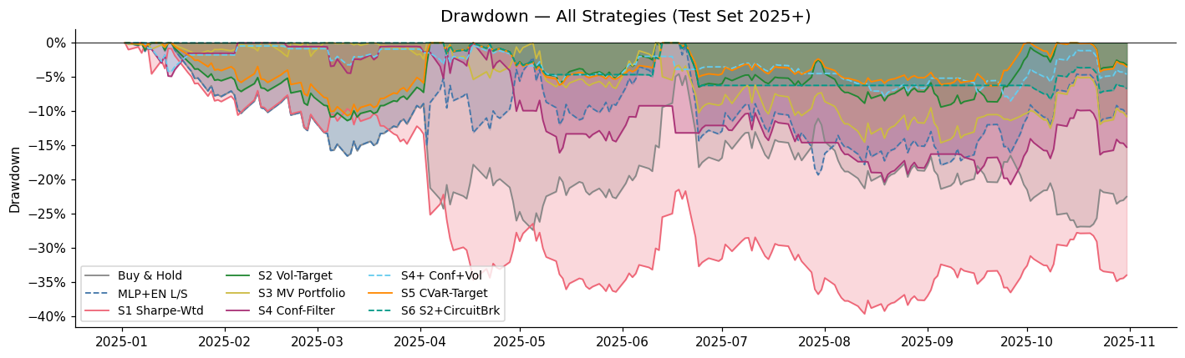
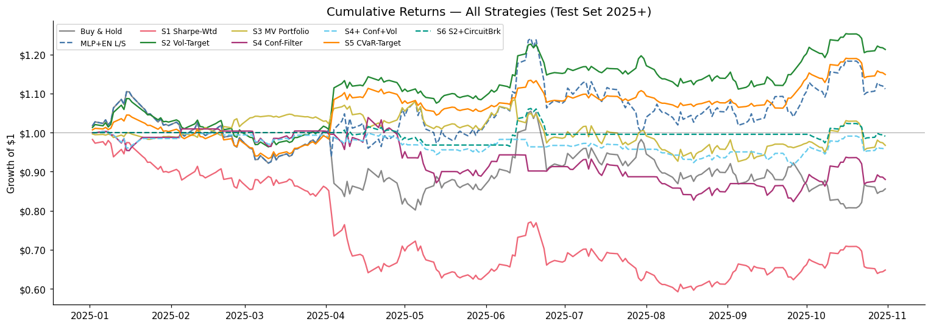
Full Results Summary
Notes:
This slide brings everything together. Let me walk through the table and then point to what the charts are showing.
Looking at the table from top to bottom - buy-and-hold lost 14.4% with a Sharpe of negative 0.512. That is the passive benchmark and it is
a rough period for WTI, driven by OPEC+ production increases and global demand concerns throughout 2025. The MLP+EN long-short baseline
from the previous presentation came in at +11.2% and Sharpe 0.406 - already a meaningful improvement over buy-and-hold just from going long
and short based on model predictions.
Then the six advanced strategies. S1 is the outlier on the downside at −35.2% - we just covered why. S2 is the clear winner at +21.3%,
Sharpe 1.386, Sortino 2.442, and max drawdown of only −11.4%. S3, S4, and S6 all cluster around flat to slightly negative. S5 CVaR-Targeted
is the second standout at +14.9% and Sharpe 1.121. S2 and S5 are the only two strategies in the entire table that beat buy-and-hold on
total return, Sharpe ratio, AND maximum drawdown simultaneously. Every other strategy either made money but had worse drawdowns, or
controlled drawdowns but gave up returns.
The drawdown chart on the left tells the story visually. The pink shaded area going all the way down to negative 40% is S1 - you can see it
deteriorating consistently from the start. The green and orange lines near the top are S2 and S5, staying relatively flat and controlled.
Buy-and-hold is the line that drifts steadily downward to around negative 27%.
The cumulative returns chart at the bottom confirms the same picture from a different angle. S2 is the green line climbing to around 1.21.
S5 tracks slightly below it. Everything else is either flat or declining. S1 is the purple line dropping to around 0.65 - that is a 35%
loss visualised.
The main conclusion from this table is not just which strategy won. It is that the spread of outcomes across six strategies using identical
underlying signals is enormous - from negative 35% to positive 21%. The direction signal was the same for all of them. Position sizing and
risk management framework explained almost all of the variation in outcomes.

Slide 6
Key Takeaways
Risk Management > Model Accuracy
Volatility Is Information, Not Just Noise
S2 and S5 succeeded not because the direction signal improved, but because they controlled how much was risked per trade. A weak signal + smart sizing beat a strong signal + naive sizing.
Using realised vol to scale position size made S2 more aggressive in calm markets and more conservative in turbulent ones - exactly the right behavior for a noisy direction signal.
Complexity Can Destroy a Working Strategy
The Direction Signal Is Real but Fragile
S6 took the best-performing strategy (S2, +21.3%) and added one rule. That rule turned it into −0.9%. Every additional mechanism is another way to fail.
Across all 6 strategies, the underlying model signals provided a kind of edge. But it only showed up when the strategy framework was built to protect it - not amplify it.
The biggest gains came from engineering around the signal's weaknesses, not from just improving the signal itself.
Notes:
I want to close with four takeaways that I think generalize beyond this specific project.
The first is that risk management matters more than model accuracy. Every strategy on the previous slide used the exact same four direction
models with the exact same predictions. The 56 percentage point spread between the best and worst strategy - S2 at +21.3% versus S1 at
−35.2% - came entirely from how positions were sized and when trading was allowed. If you had spent that same energy trying to push model
accuracy from 52% to 53%, you would have gotten almost nothing in return. The leverage is in the strategy framework, not the classifier.
The second is that complexity can destroy a working strategy. S6 is the clearest example I have seen of this. One additional rule, which
seemed like a reasonable safeguard, erased 22 percentage points of return. The instinct to add more rules to protect a strategy is
understandable but dangerous. Every rule you add is a new assumption about how the market works, and if that assumption is wrong it does
not just fail to help - it actively hurts. The simpler S2 without the circuit breaker outperformed S2 with it by a wide margin.
The third takeaway is that volatility is information. Most people think of market volatility as something to be endured or hedged away. S2
treats it as a direct input into position sizing. When vol is high, reduce exposure. When vol is low, increase it. This sounds simple but
it has a compounding effect: the strategy naturally becomes more conservative during the periods when the direction signal is least
reliable, and more aggressive during the periods when it is most reliable. That alignment between signal quality and position size is what
produced the Sortino ratio of 2.442 - meaning the strategy's upside volatility was much larger than its downside volatility.
The fourth takeaway is about the nature of the direction signal itself. Across all six strategies and all four models, there is a genuine
edge in the predictions - it is just fragile. It only shows up clearly when the strategy framework is designed to protect it. The moment
you overlay a mechanism that amplifies noise, like S1's dynamic reweighting, or one that cuts you out at the wrong time, like S6's circuit
breaker, the edge disappears. The signal is real but it needs to be handled carefully.
The closing line on the slide summarizes all four points: the biggest gains came from engineering around the signal's weaknesses, not from
improving the signal itself. That is probably the single most important thing I learned from this entire project.

Slide 7
Thank You

